Slide 1
Windows applications and their alternatives in Gnu/Linux
Written by Sohrab Behdani
2023-03-01
under GNU FDL license

Slide 2

Chapter 1 : Graphic Design

Slide 3
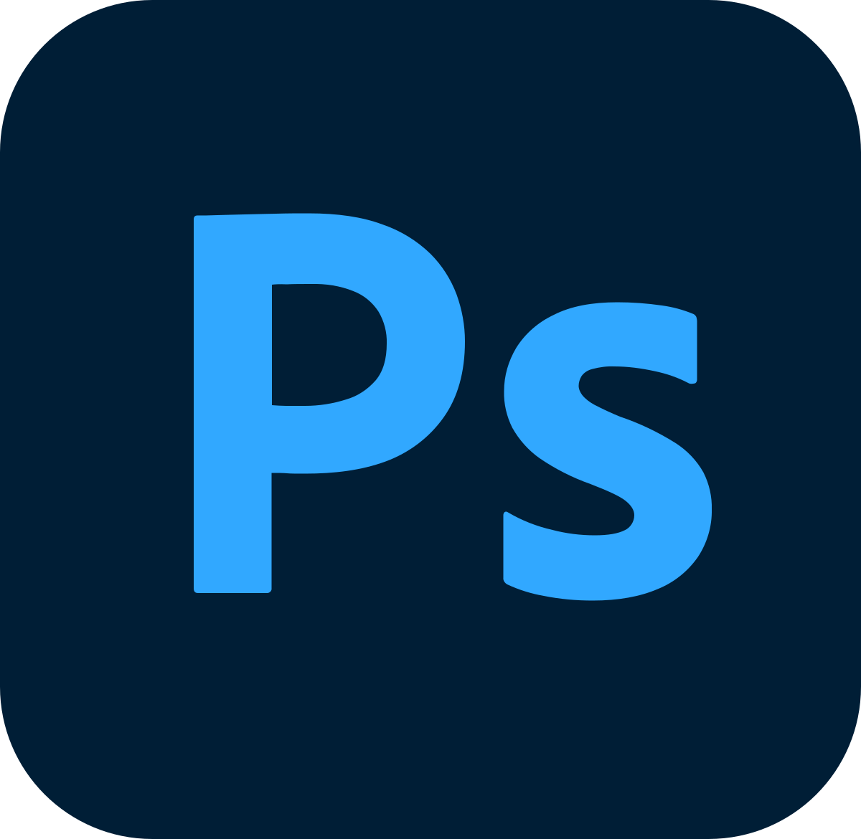
Adobe Photoshop
1. GIMP ( GNU Image Manipulation Program )
2. KDE Krita
3. Graphite
4. Photopea

Slide 4
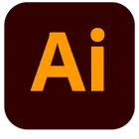
Adobe Illustrator
1. Inkscape
2. Apache OpenOffice Draw
3. sk1
4. Graphite
5. LibreOffice Draw

Slide 5

Corel Draw
1. Inkscape
2. Apache OpenOffice Draw
3. sk1
4. Graphite
5. LibreOffice Draw

Slide 6

Paint.net
1. GIMP
2. Krita
3. Pinta
4. Gnome Drawing
5. Kolour Paint

Slide 7

Adobe Lightroom
1. Darktable
2. RawTherapee
3. Kde Digikam
4. Shotwell

Slide 8

Adobe InCopy
1. Manuskript

Slide 9

Adobe InDesign
1. Scribus
2. LaidOut

Slide 10
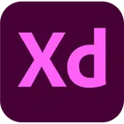
Adobe Xd
1. Penpot
2. Figma
3. Pencil Project
4. Akira
5. Wireflow
6. mydraft.cc
7. Moqups

Slide 11

Chapter 2 : Screen capture and video editors

Slide 12

Adobe Premier
1. Kdenlive
2. Pitivi
3. DaVinci Resolve
4. Shotcut
5. Olive Video Editor
6. OpenShot
7. Cinelerra

Slide 13

WonderShare Filmora
1. Kdenlive
2. Pitivi
3. DaVinci Resolve
4. Shotcut
5. Olive Video Editor
6. OpenShot
7. Cinelerra

Slide 14

Camtasia
1. OBS studio
2. Natron
3. SimpleScreenRecorder
4. Kazam
5. VokoscreenNG
6. Kooha

Slide 15

Bandicam
1. OBS studio
2. SimpleScreenRecorder
3. Kazam
4. VokoscreenNG
5. Kooha

Slide 16

ZD Soft Screen Recorder
1. OBS studio
2. SimpleScreenRecorder
3. Kazam
4. VokoscreenNG
5. Kooha

Slide 17

ActivePresenter
1. OBS studio
2. SimpleScreenRecorder
3. Kazam
4. VokoscreenNG
5. Kooha

